Slide 1



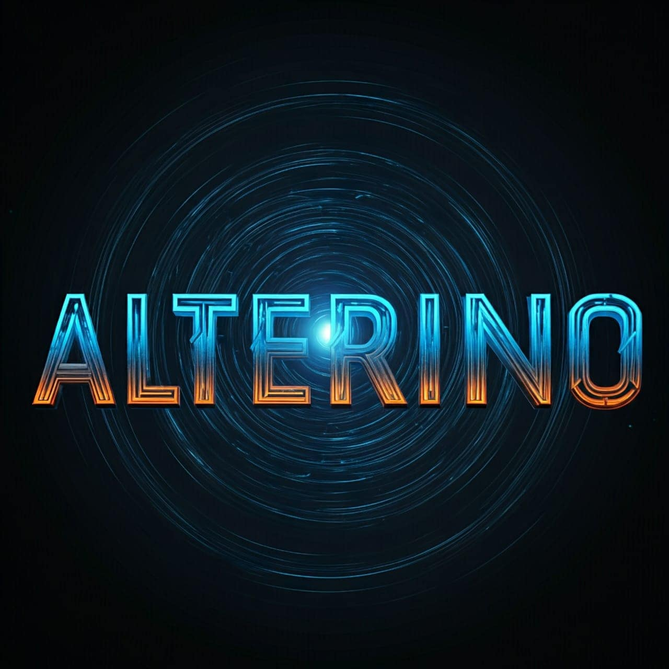




CODING CLUB BMSIT × ALTERINO CLUB BMSIT
NIRMAAN 2026
Build. Innovate. Impact
Team Name: Uno-Pi
Team Leader: Srivatsan A
Chosen Track: Open Innovation
Problem Statement: AI-Powered Mine Safety & Rescue System

Slide 2

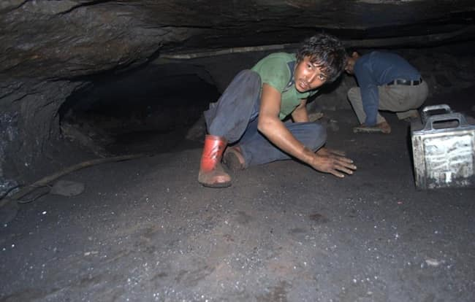
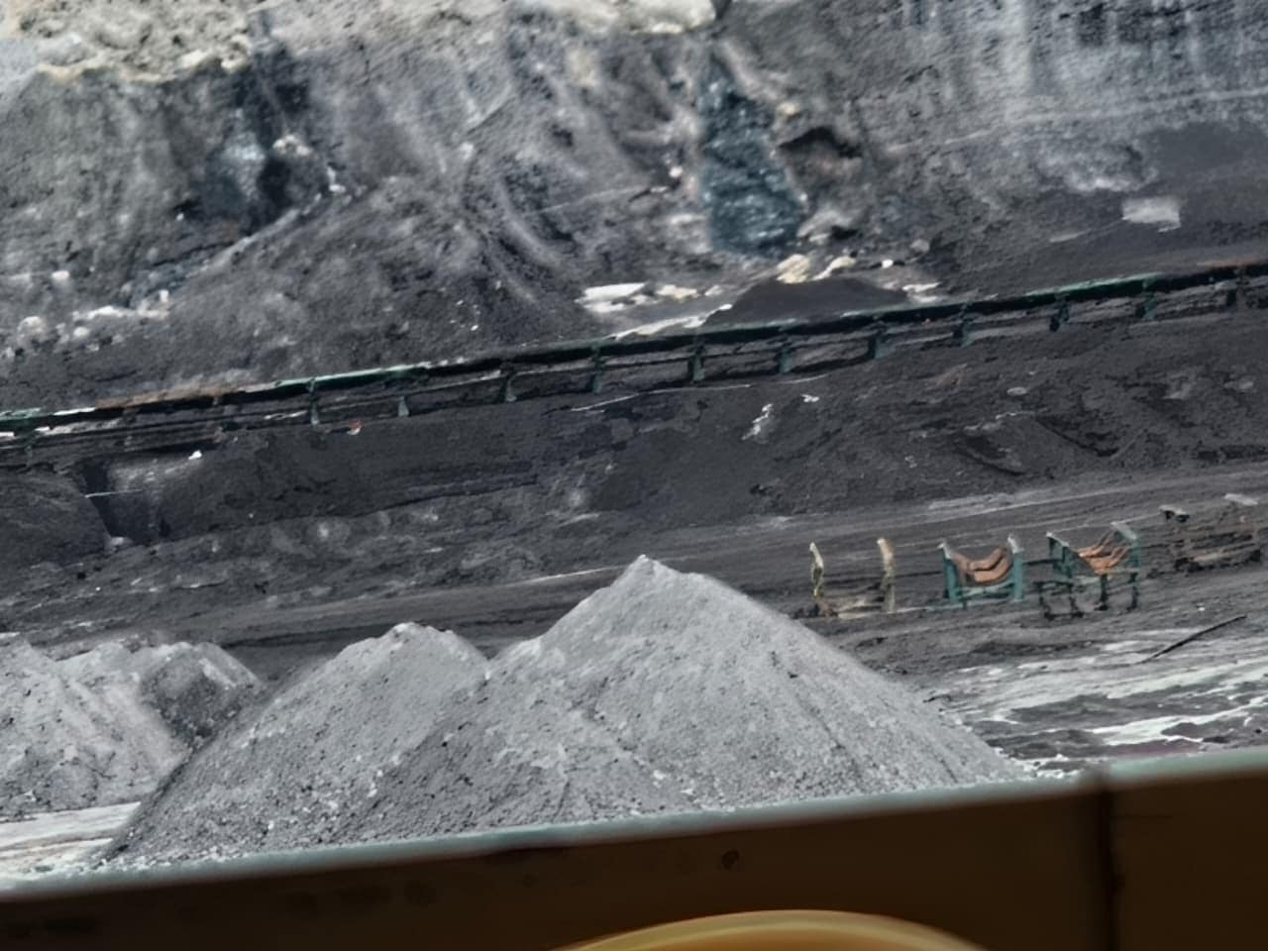
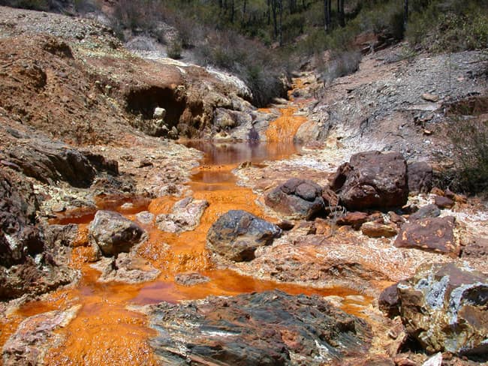
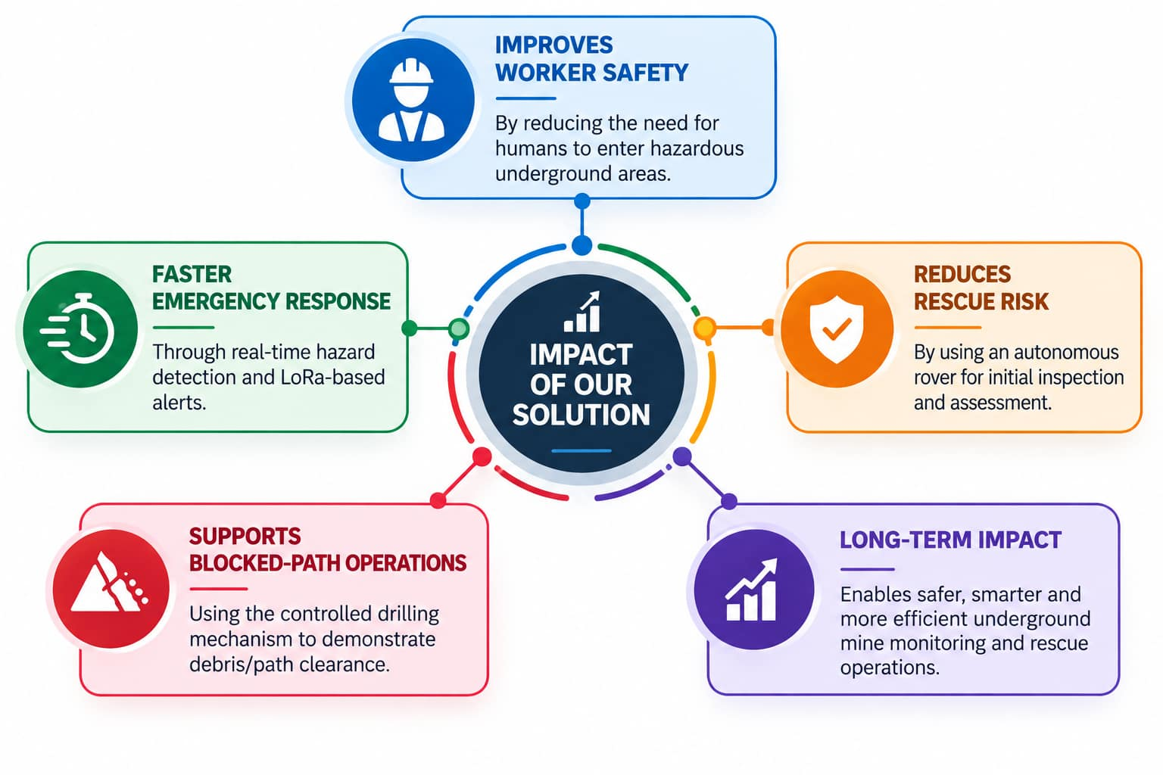
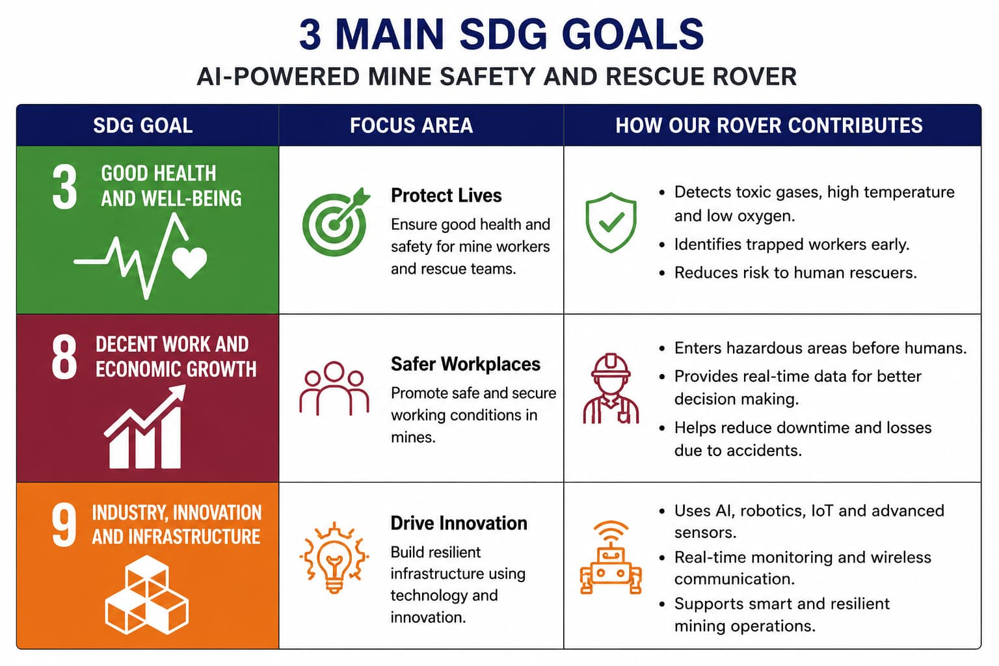
Problem Statement & Real-World Impact
(Problem given organization: Govt. of Jharkhand)
Mining accidents can seriously affect the lives and safety of workers, especially in dangerous and unstable mine environments.
During rescue operations, entering the affected area can also put rescue team members at risk.
There is a need for a robotic system that can enter hazardous areas before humans and provide real-time information about the situation.
The system should help detect trapped workers, monitor dangerous gases and environmental conditions, and support safe and effective rescue operations.
“Jharkhand is one of India’s major mining states, with 1,104 major and minor mines.”
Recently, some workers got trapped in a rat hole mining coal mine in Dima Hasao district of Assam due to flooding. Despite rescue operations by several state and central agencies, many workers died. (6 January 2025)
https://www.sanskritiias.com/current-affairs/challenges-and-solutions-of-rescue-operations-in-mining-areas
The Chasnala mining disaster was a disaster that happened on 27 December 1975 in a coal mine in Chasnala near Dhanbad in the Indian state of Jharkhand. An explosion in the mine followed by flooding killed 375 miners.
https://en.wikipedia.org/wiki/Chasnala_mining_disaster#:~:text=With%20a%20death%20toll%20of%20375%2C%20Chasnala,the%20mine%20had%20no%20high%20pressure%20pump.
Dhanbad disaster: All 54 miners killed, The miners were killed after being trapped about 500 metres underground in an inferno of blazing methane gas. https://timesofindia.indiatimes.com/india/dhanbad-disaster-all-54-miners-killed/articleshow/1967485.cms
Absence of Dedicated Rescue Stations in the Quarry Sector: While major lignite operations (NLC India, Neyveli) maintain trained personnel under the Mines Rescue Rules (1985), the thousands of minor mineral quarries operate without statutory rescue stations, leaving emergencies to general civil defence or standard fire services untrained in mining dynamics.

Slide 3
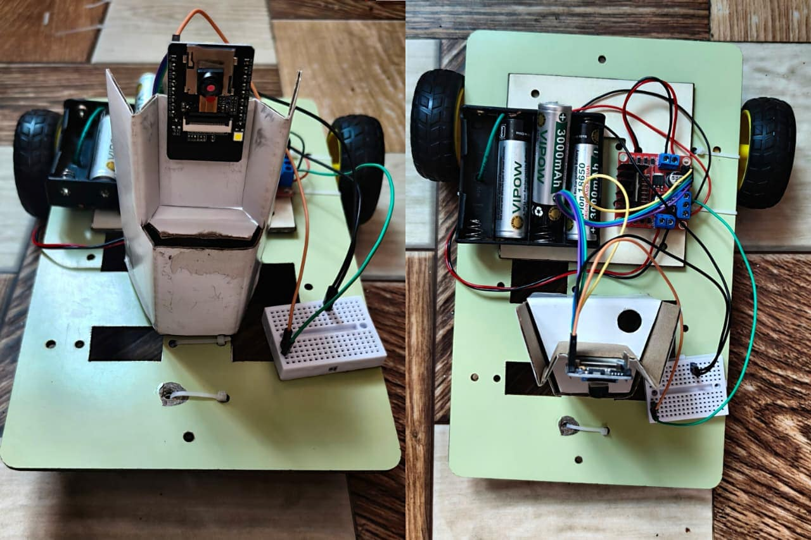
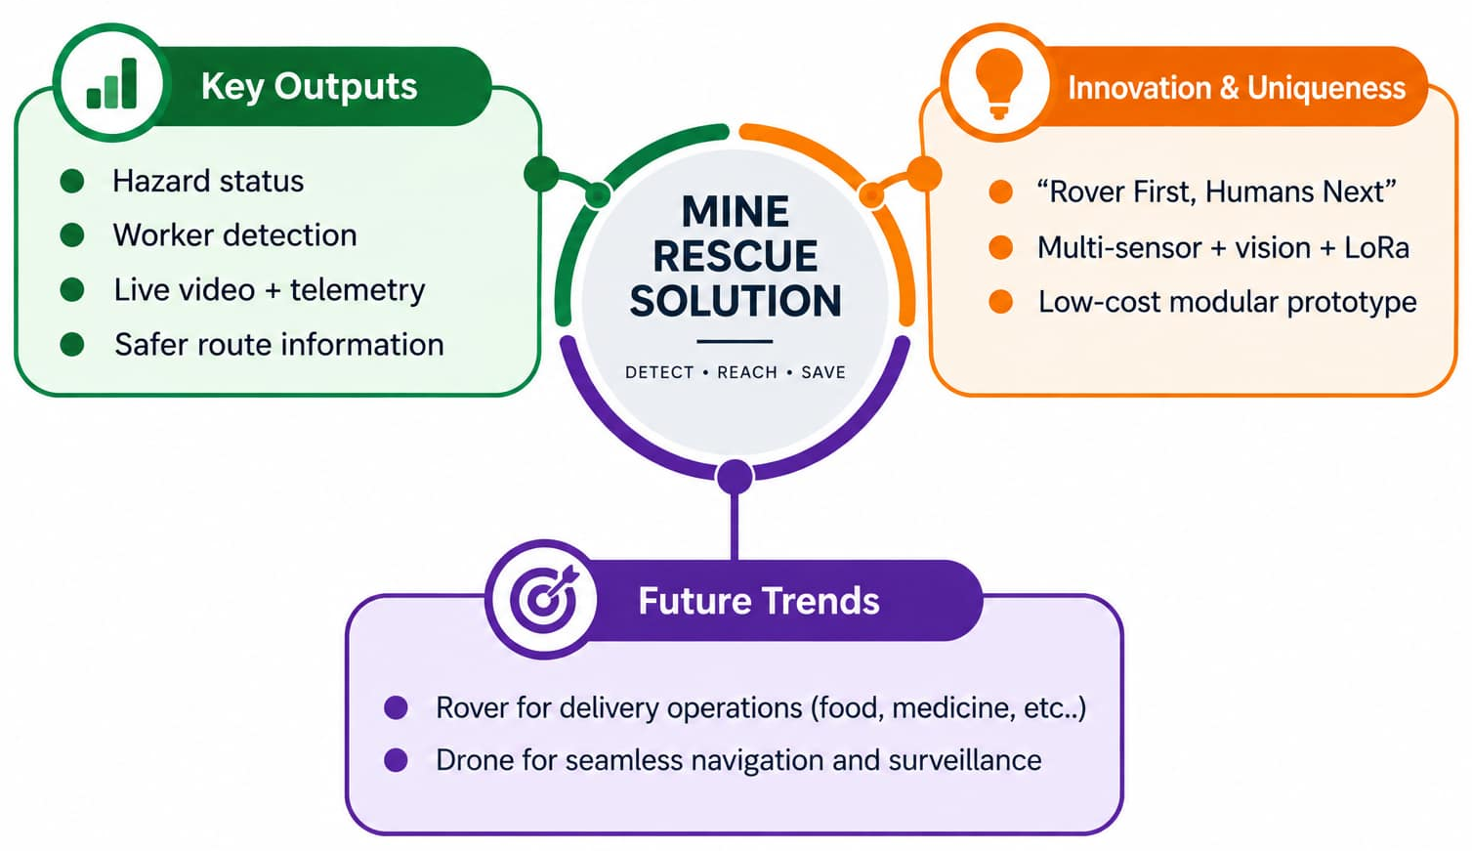
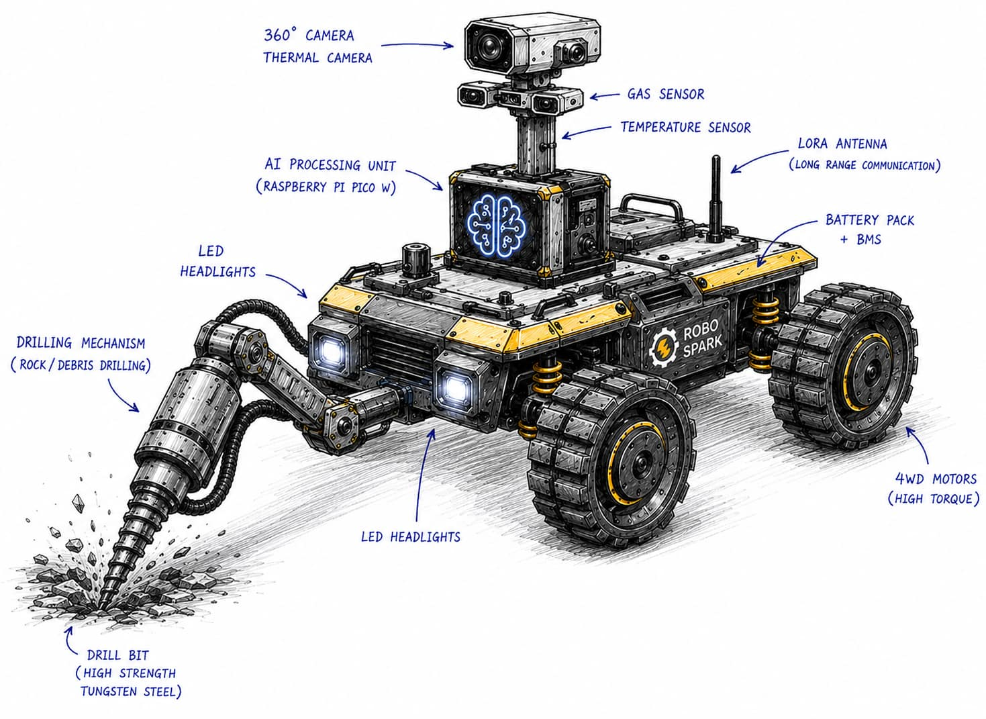
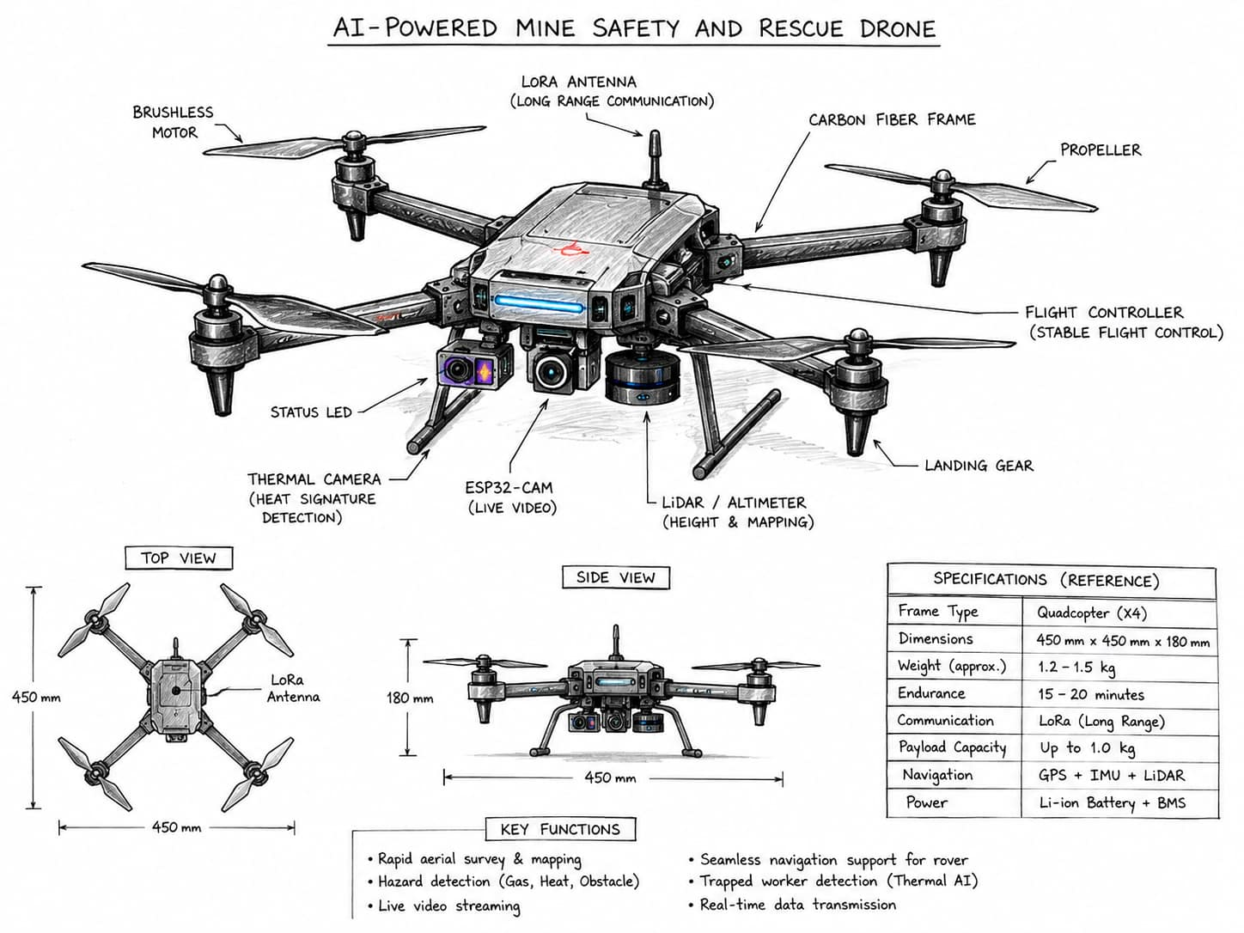
Proposed Solution & Innovation
Proposed Solution
Develop an AI-powered autonomous mine rescue rover to safely monitor and operate in hazardous underground environments.
Integrate gas, temperature, humidity and obstacle sensors with cameras to detect hazards, obstacles and trapped workers.
Use AI-based vision and sensor analysis for real-time detection and intelligent navigation.
Use LoRa communication to transmit live environmental data, alerts and rover status to the rescue team.
A controlled drilling mechanism can clear or access simulated debris/blockages, supporting safer rescue operations.
The rover is the primary rescue platform, while the drone is the secondary navigation and rapid-survey platform.
Our Prototype (Rover)
1 SENSE
Gas • Temperature • Camera • Distance
Use the below link to know more details
https://drive.google.com/drive/folders/1NFqph8P6IPNAZXV6ouK-oHCO32ejffgh?usp=drive_link
2 THINK
Controller + AI-assisted hazard analysis
3 ACT & REPORT
Move • Alert • Send live data
Problem analysis
Hazardous Mine Conditions: Underground coal mines face toxic gas leaks, tunnel collapses, flooding, and poor visibility.
Lack of Real-Time Information: Rescue teams cannot easily monitor underground conditions or locate trapped workers during emergencies.
High Risk to Rescuers: Human rescue teams must enter dangerous areas, increasing rescue time and the risk of injuries or casualties.
Expected outcome

Slide 4
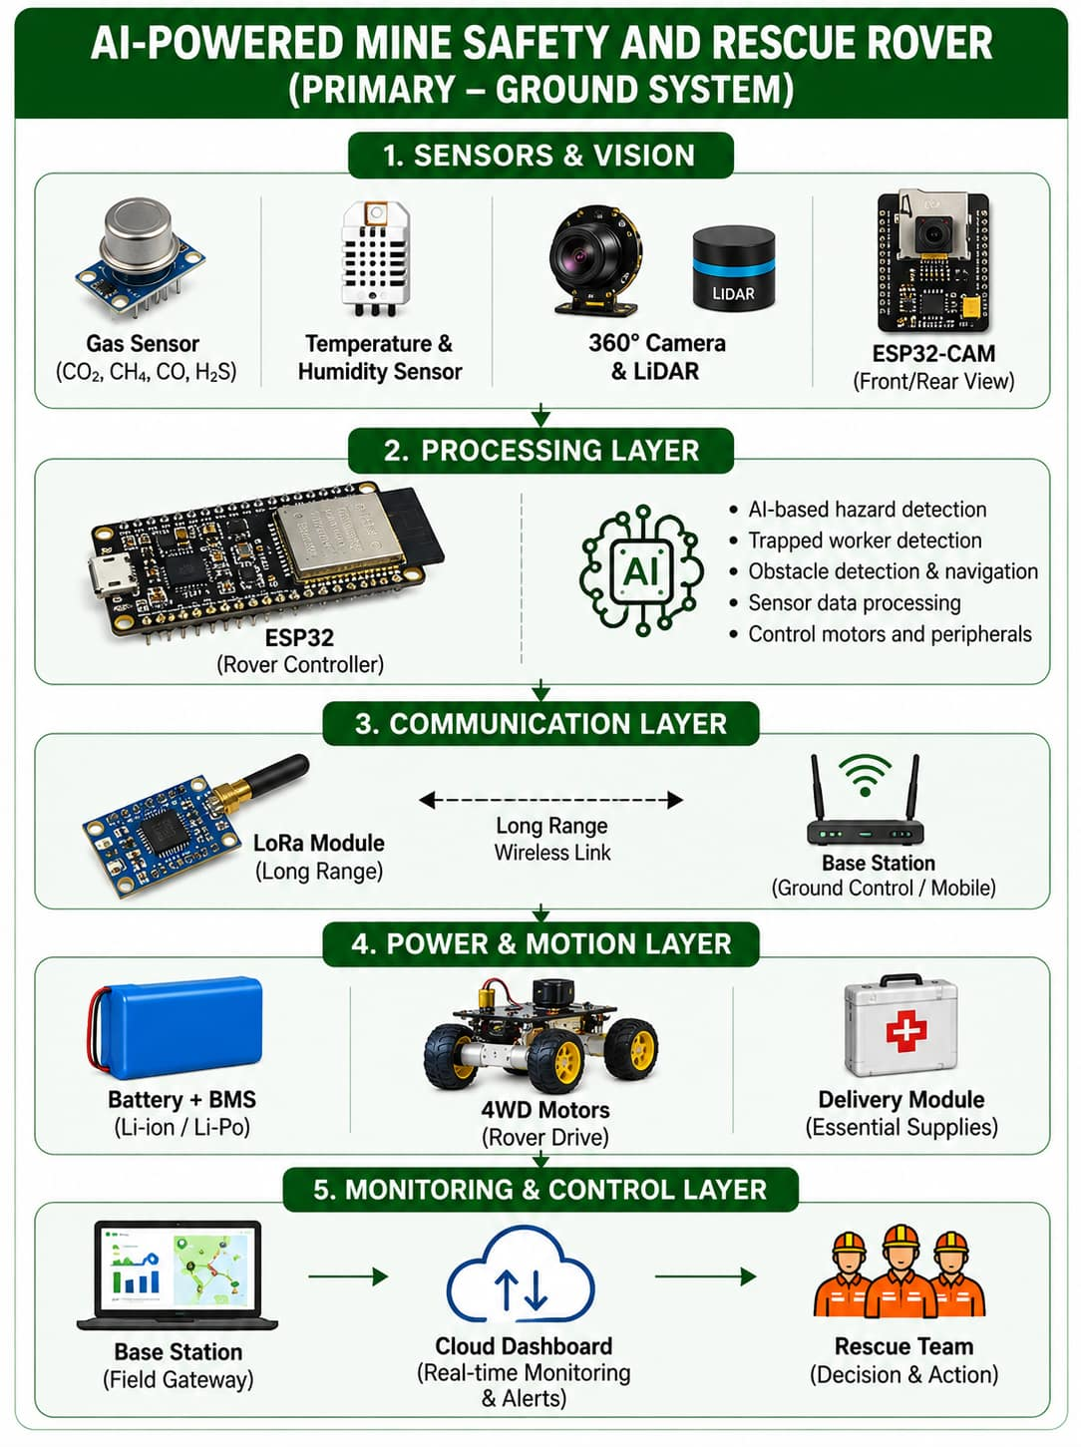
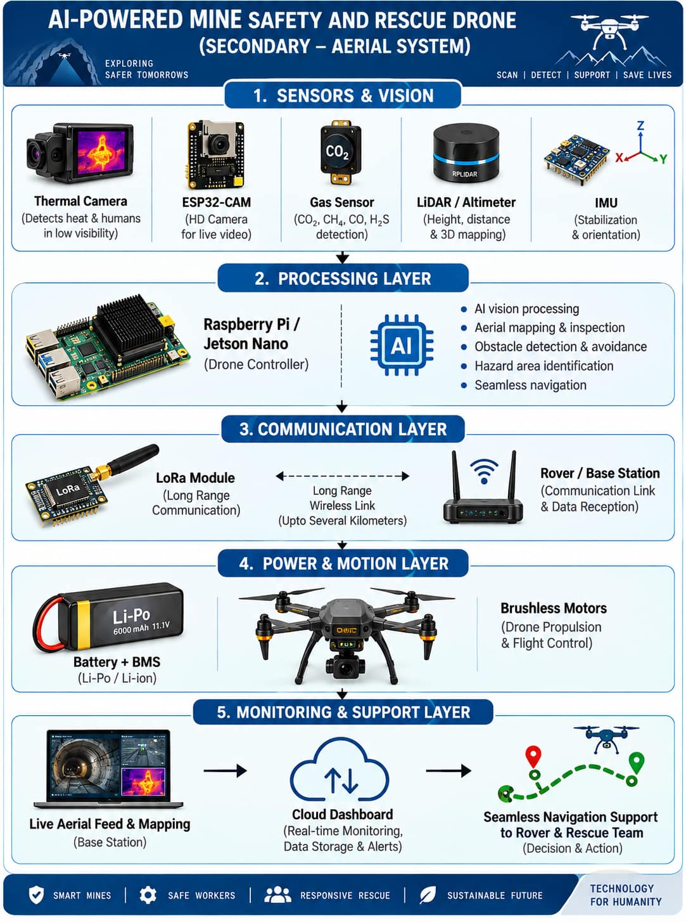
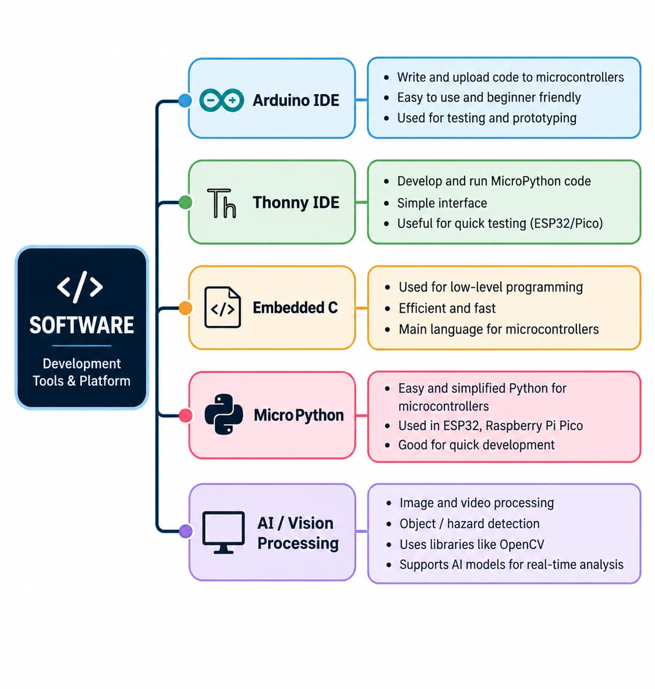
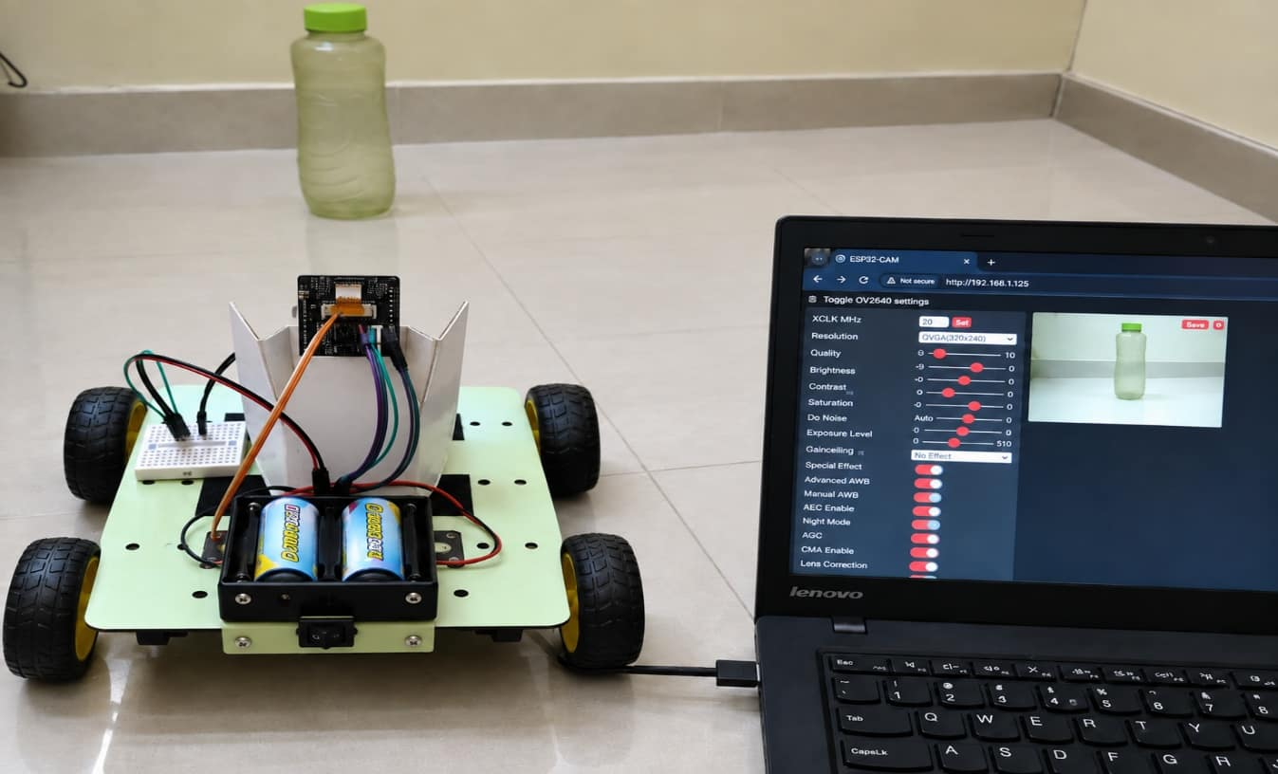
System Architecture & Technical Implementation
We use RTOS based system, for multitasking on real time.
Task 1 - Gas Monitoring
Task 2 - Temperature Monitoring
Task 3 - Camera / Vision Monitoring
Task 4 - AI Processing
Task 5 - Rover Navigation
Task 6 - Drilling Control
Task 7 - Wheel / Belt Drive Control
Task 8 - Delivery Module Control
Task 9 - Drone Navigation
Task 10 - LoRa Communication
Task 11 - Emergency Alert
Task 12 - Battery & BMS Monitoring
Task 13 - Cloud / Dashboard Monitoring
Task 14 - System Health Monitoring
Task 15 - Data Logging

Slide 5
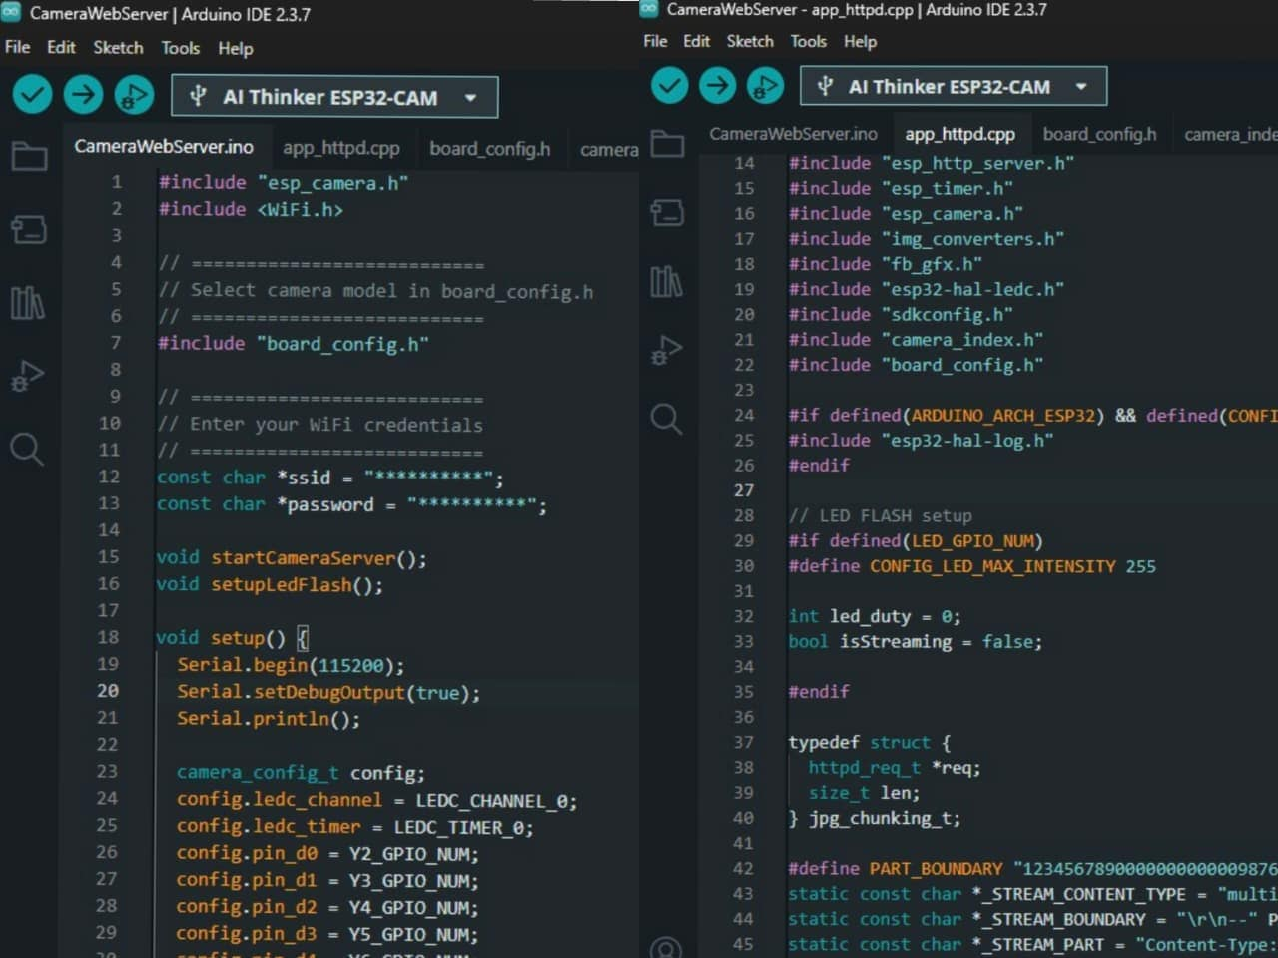
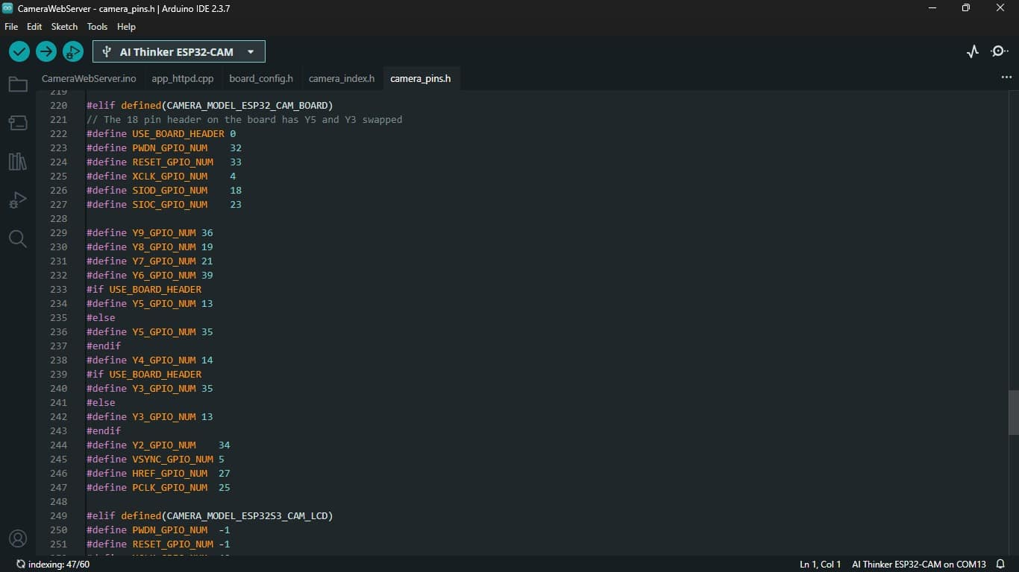
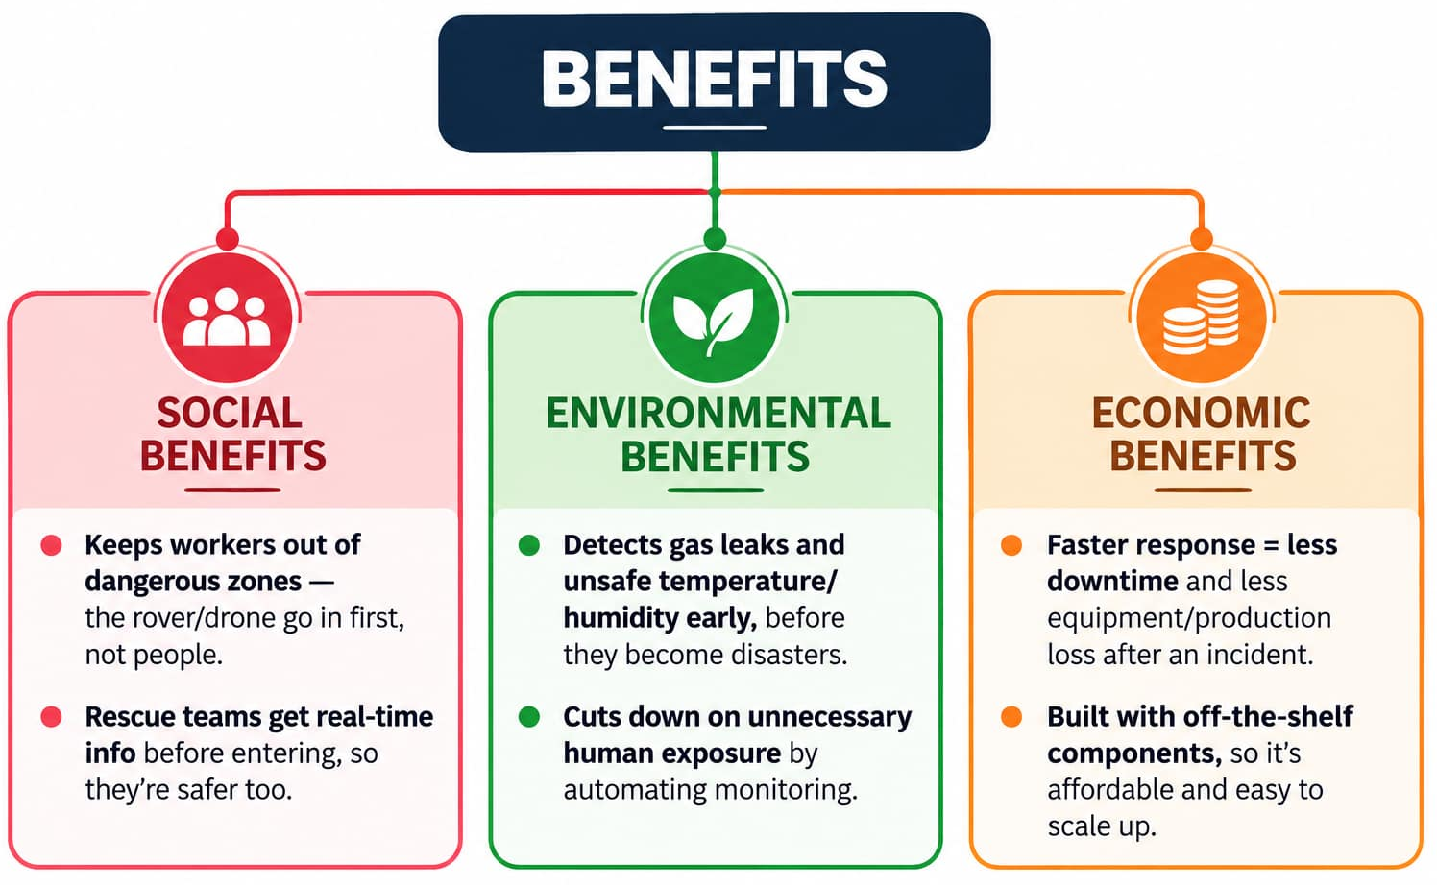
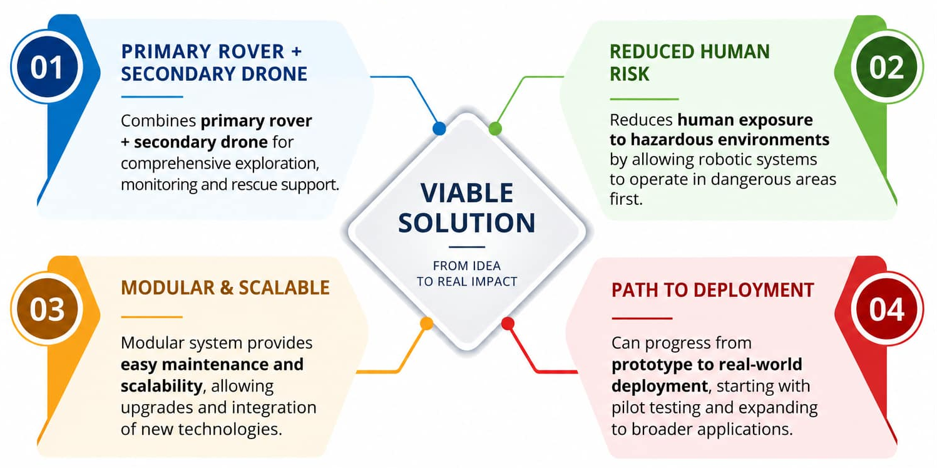
Demo Plan & Future Roadmap
Live Demo Strategy:
  Drive the rover through a simulated mine path with obstacles and low-visibility sections.
  Show live gas/environment readings, camera feed, LoRa telemetry and hazard alerts at the base station.
  Demonstrate worker/hotspot detection, emergency-supply delivery and route support from the secondary drone concept.
Expected Deliverables:
  Functional low-cost rover prototype with sensor monitoring, remote/autonomous movement and live alerts.
  Working communication/dashboard demonstration plus documented rover–drone architecture and test results.
Future Scope & Roadmap:
  Short Term: improve AI detection, sensor calibration, rugged enclosure and battery/BMS monitoring.
  Mid Term: integrate thermal camera, LiDAR mapping, stronger mesh/relay communication and coordinated drone navigation.
  Long Term: mine-grade ruggedization, autonomous mapping/SLAM, multi-rover deployment and field trials with mining/rescue agencies.
Future Trends
Rover for delivery operations (food, medicine, etc..)
Drone for seamless navigation and surveillance

Slide 6
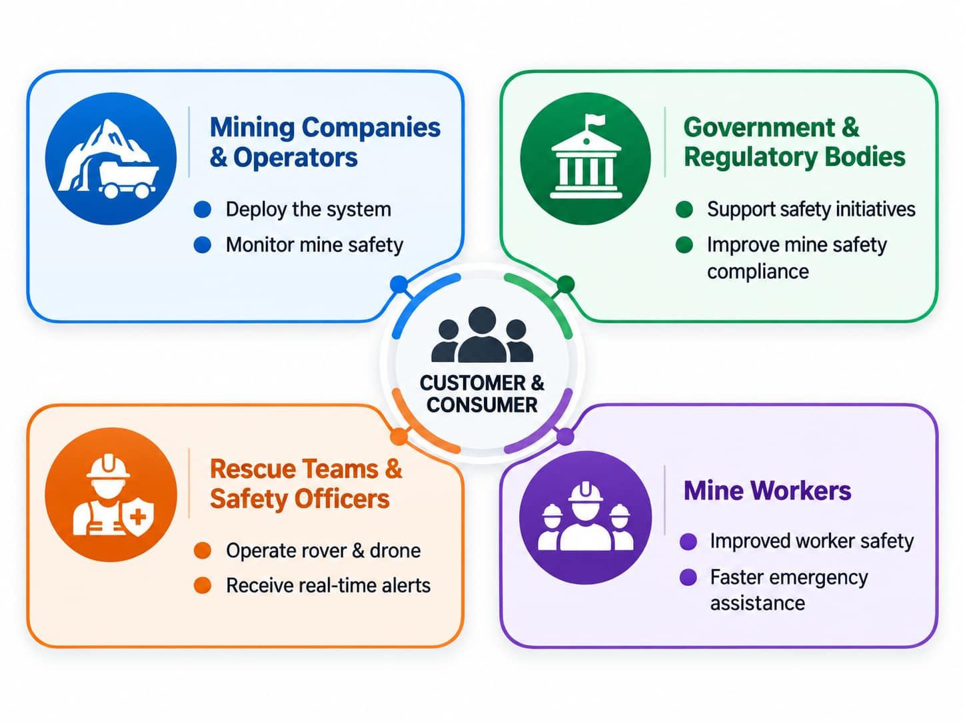
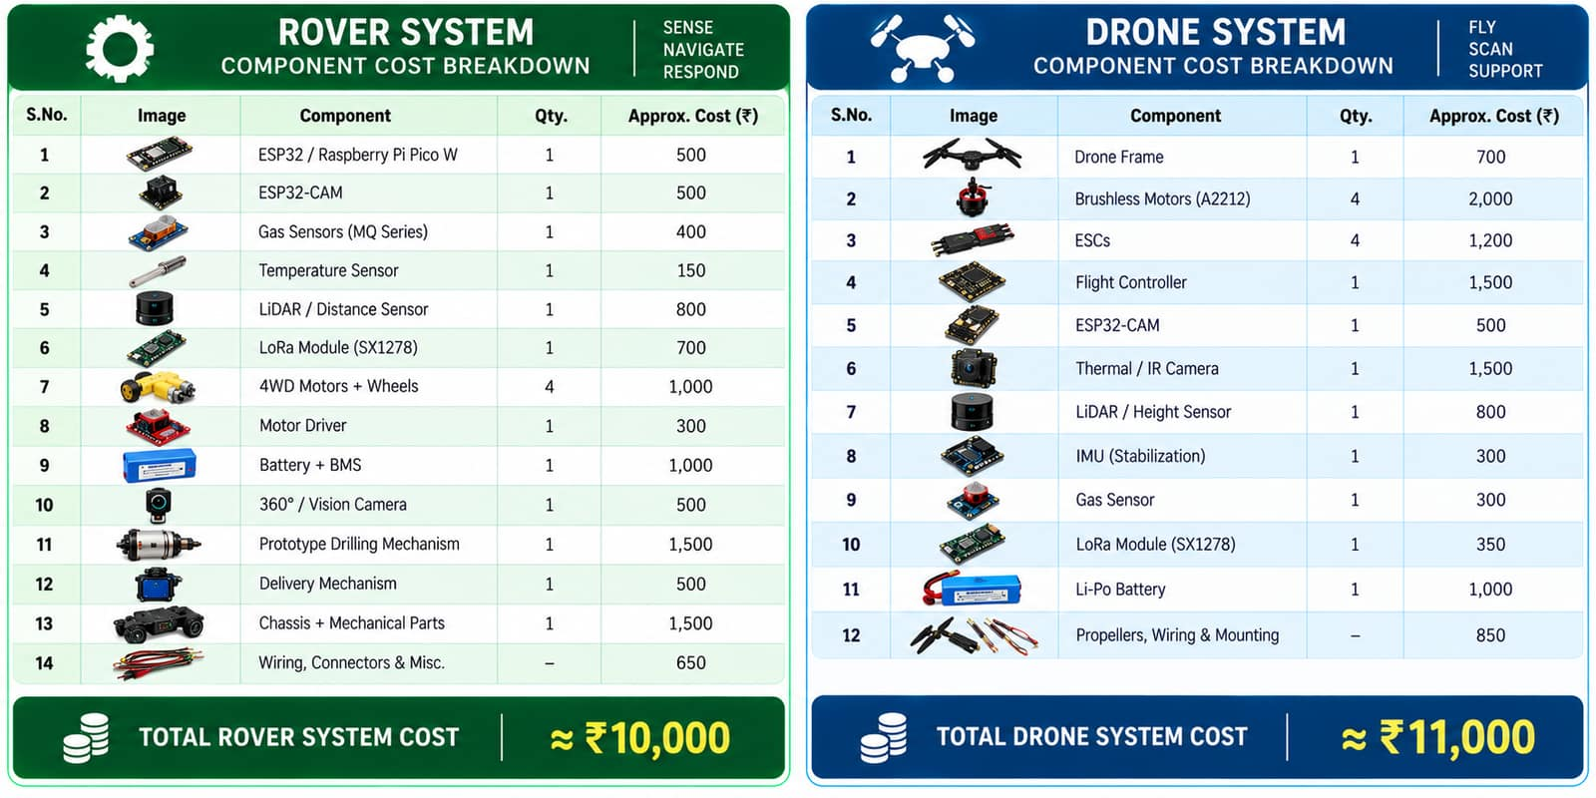
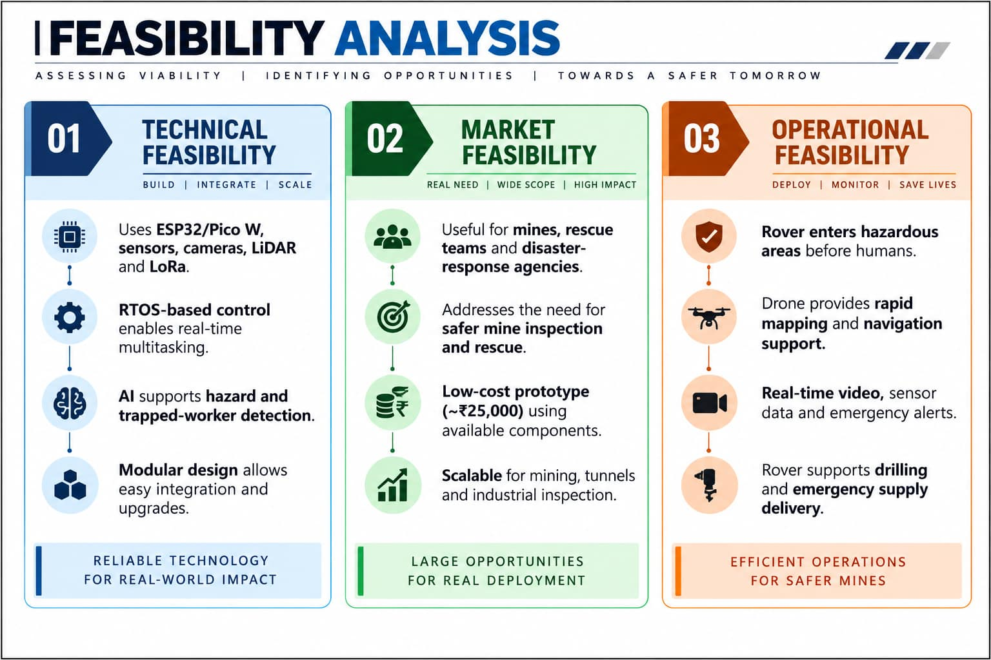
24-Hour Grand Finale Build Scope & Feasibility
24-Hour Build Scope:
  Integrate the rover controller, sensors, camera, motor drive and LoRa link; implement real-time monitoring and alert logic.
  Complete a live obstacle/hazard demo and connect telemetry to a simple base-station/dashboard view.
Component Checklist:
  Hardware: ESP32 / Pico W, ESP32-CAM, gas sensor, temperature/humidity sensor, ultrasonic/LiDAR, motor driver, DC motors, LoRa, battery/BMS, chassis.
  Embedded system: Arduino IDE / Thonny, Embedded C / MicroPython, RTOS task structure, AI/vision module and data logging.
Feasibility & Scalability:
  Uses readily available off-the-shelf components and a modular architecture; prototype target cost is about ₹25,000.
  Can scale from a competition prototype to mining, tunnel and industrial-inspection applications by upgrading sensors, enclosure, communication range and autonomy.

Slide 7
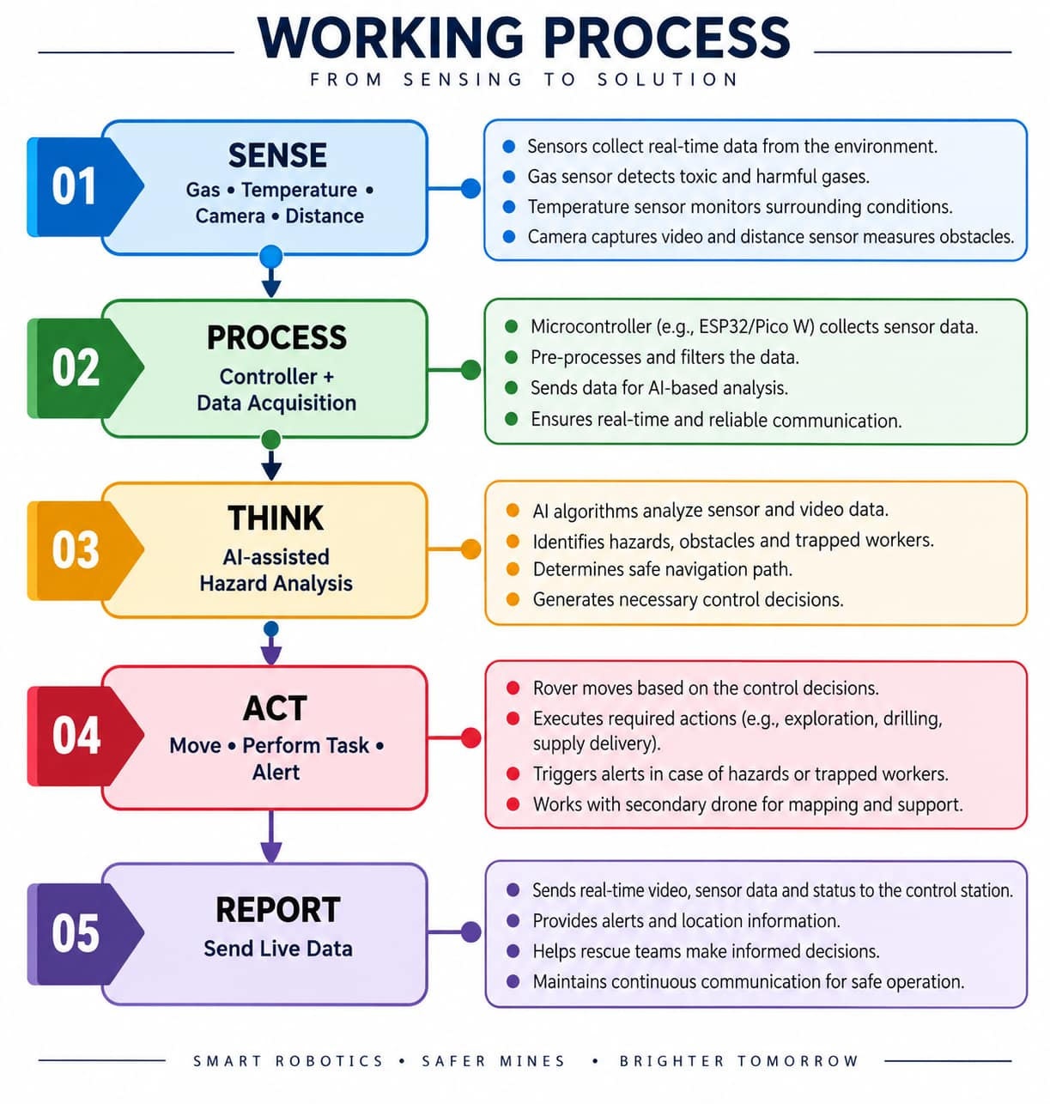
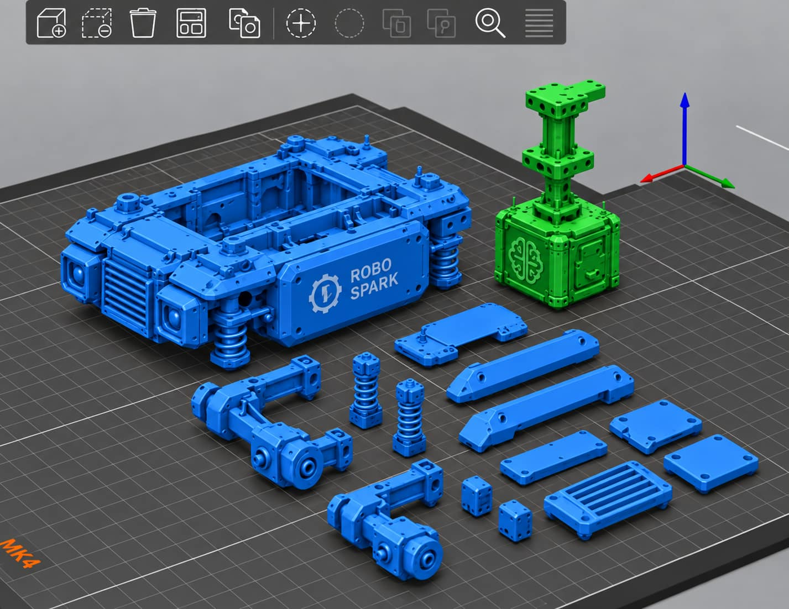
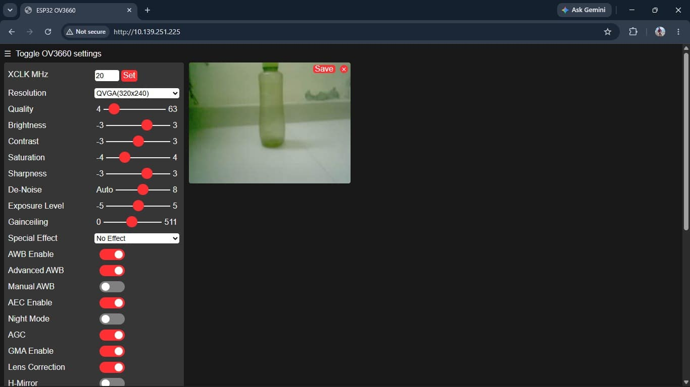
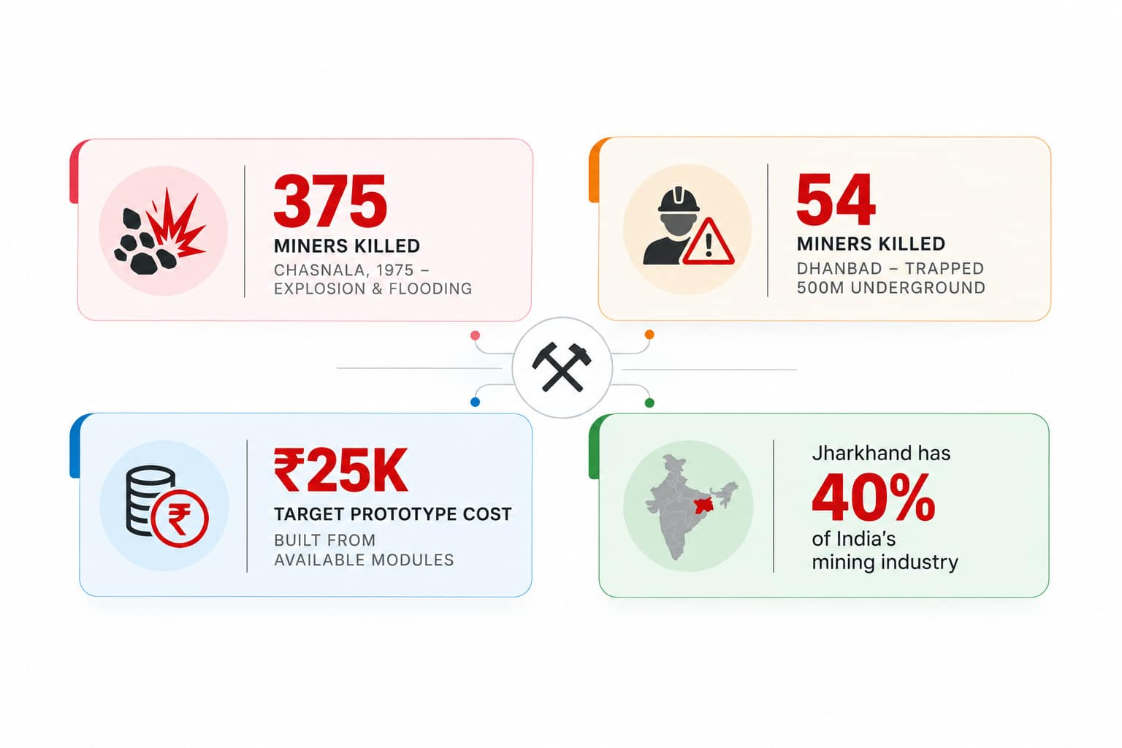
SENSORS & VISION
Gas • Temp/Humidity
Camera • Distance/LiDAR
PROCESSING
ESP32 / Pico W
RTOS + AI analysis
COMMUNICATION
LoRa wireless link
Alerts + telemetry
BASE STATION
Dashboard / Mobile
Rescue-team decisions
Work Flow
Design
Innovation
Combines an AI-powered rover and drone into one coordinated mine-safety system.
AI combines data from gas, temperature, vision and environmental sensors to detect hazards.
Rover + drone cooperation provides complementary ground and aerial information.
Thermal vision can assist in detecting people in low-visibility areas.
Creates a real-time safety picture of the mine to help rescuers make informed decisions.

